Slide 1
Domestic Violence and Rape
A survivor’s story

Slide 2
If you throw a frog in a pot of boiling water, it will hop right out. But if you put that frog in a pot of tepid water and slowly warm it, the frog doesn’t figure out what’s going on until it’s too late.
Boiled frog.
It’s just a matter of working by slow degrees.
Stephenie Meyer

Slide 3


This is a story of domestic violence. It is only one story out of millions.
She was a happy child in many ways, but her family situation and childhood experiences had left her vulnerable.
A couple of early relationships let her down and she desperately wanted to be loved and to find that special someone she would spend forever with.

Slide 4

At the age of 21 she met someone online. They chatted for a long time online and later by phone.
After several months they agreed to meet in Blackpool while he was there for work.
They hit it off straight away.
Long distance relationships are hard, so they hadn’t been dating long when he agreed to move down from Scotland to stay with her at her parents’ house.

Slide 5

He got a job.
She was doing well at college and work.
She was happy.

Slide 6


The first time he hit her it came out of the blue. A small argument. A slap across the face. Followed by an apology. He hated himself. Said he wouldn’t blame her if she kicked him out and never saw her again. He cried.
She comforted him. It was horrible to see him so upset over a ‘little slap’.
Getty

Slide 7

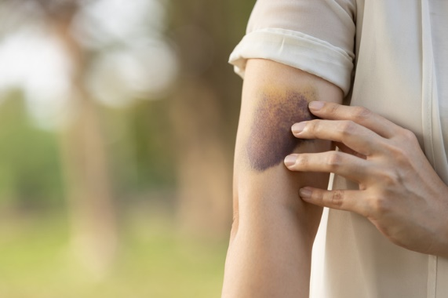
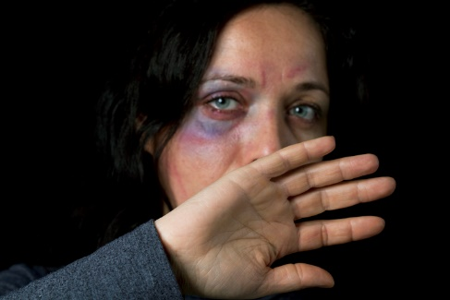
Over the next 12 months the slaps got worse.
Then punches, kicks, bites, burns. Black eyes, split lips, cracked ribs, dislocated wrist, fractured arm.
Concussion.

Slide 8


She stopped spending time with friends.
Dropped out of her studies because she fell behind.
Work pulled her in for disciplinary action because she had missed a few days here and there, had let her appearance slip, and they weren’t happy that her partner had showed up at the office on a couple of occasions and been disruptive while assaulting her.

Slide 9

One day at work, on her lunch break, he called to say he was on his way. He was in one of his moods. She didn’t have any strength left. She was tired.
She wanted a rest. Needed an escape.
She waited by the side of the road for her opportunity and then stepped out. The car hit her, and she was thrown down the road. An ambulance was called. The driver was unhurt and the car undamaged. She had minor injuries. She was discharged later that day.
Her doctor placed her on sick leave.
That was the last day she would go to work.

Slide 10


She regularly attended church and had for most of her life. She was relatively new to her local church after moving to the area only a couple of years previously. She enjoyed going and stayed after service for refreshments. She was shy but people made her feel welcome and chatted with her kindly.
As the level of abuse grew the signs were obvious. People noticed the bruises. She found it harder to make eye contact and retreated into herself. But she kept staying for refreshments after service. However people withdrew from her. They would drop their heads as she came to the hatch for a drink. Nobody sat next to her in the hall any more. People gathered in small groups, whispering and glancing at her. She felt ashamed. Eventually she stopped going.

Slide 11

Over the next few months the beatings got worse.
Totally isolated from the outside world, there was no holding him back.
He had stopped working to be with her all the time.

Slide 12
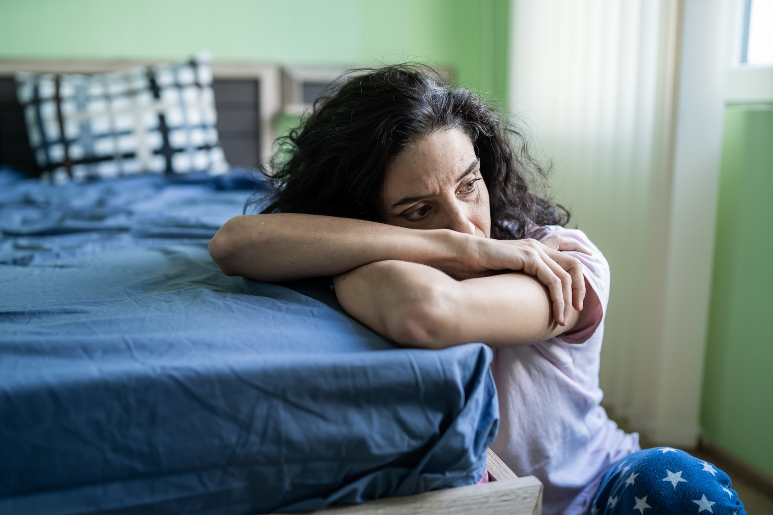
She had always suffered with blackout seizures but these became more frequent and then she started with convulsive fits, especially at night.
He had been forcing her to have sex for months but once the convulsive fits started he would take advantage of her inability to fight back and the rapes became a nightly thing causing her intimate injuries.

Slide 13

The police were called on a number of occasions by either herself or her mum but they would just take him away for a while to calm down and then he was allowed to return. She was told to leave him. But it was her mum’s house. Where could she go?
During one very violent incident her mother tried to intervene. He pushed her mother out of the way; she fell and hit her face on a nearby stool. He had never hurt anyone else before. This time the police took him away, locked him up for the night, and he was not allowed to return to the house.
Escaping him was not going to be easy even after he lived out of the home. She finally gained her freedom six months later.

Slide 14


Over the next eight years she got back into her studies and earned a place at university. She met someone new and got married. She was able to get help to deal with the trauma she had suffered, and she grew stronger.
Although she had many happy times with her husband, the relationship was unhealthy, and he was very controlling. The more she grew stronger the worse he got and so eventually she ended it. At the age of 30 she was starting her life over.

Slide 15

During almost all those eight years her previous partner had stalked her and threatened her.
Damage had been done to her property and on two occasions she was assaulted from behind while out alone.
She knew who it was but there was never enough evidence. Being single now left her vulnerable but she was determined to not let it control her life.

Slide 16

A few months later she went out the back of her home to put the bins out for collection and he attacked her. An elderly lady saw what was happening and opened her door screaming for help.
He ran off.
She had been stabbed.
The police decided action needed to be taken and an arrest warrant was issued. She was not badly injured and recovered quickly. However, before he could be arrested he assaulted his current girlfriend very badly.
After his arrest he was found to be mentally unstable and has been in a secure hospital since.

Slide 17

She continued to get stronger.
She got more help. She took control. She found a great man and fell in love. She went on to have three beautiful children.
Although she still has the scars and the mental and physical problems from her past, now at the age of 40 she uses what happened to her to help others.

Slide 18
As we said at the beginning this is just one story out of millions.
Domestic Violence Statistics
There are over one million incidents of domestic violence reported every year with many more not reported.
There has been a 9% increase in reported incidents since March 2020.
In the year April 2020 to April 2021 one fifth of all crime reported was domestic abuse related.
Before seeking help women will endure upward of 50 incidents of domestic violence and wait on average three years.
Two women are killed on average EVERY WEEK.

Slide 19
Rape Statistics
One in two rapes against women are carried out by their partner or ex-partner.
Last year police received more than 63,000 reports of rape.
Fewer than one in six report to the police.
Only 1.3% of reported rapes result in a charge.
One per cent of reported rapes result in conviction.

Slide 20
What can we do? (Part 1 of 2)
Here is some practical advice from Women’s Aid on how you can help if you suspect someone is suffering domestic violence
How you can help
Listen to her, try to understand and take care not to blame her. Tell her that she is not alone and that there are many women like her in the same situation.
Acknowledge that it takes strength to trust someone enough to talk to them about experiencing abuse. Give her time to talk, but don’t push her to go into too much detail if she doesn’t want to.
Acknowledge that she is in a frightening and very difficult situation.
Tell her that no one deserves to be threatened or beaten, despite what her abuser has told her. Nothing she can do or say can justify the abuser’s behaviour.
Support her as a friend. Encourage her to express her feelings, whatever they are. Allow her to make her own decisions.
Don’t tell her to leave the relationship if she is not ready to do so. This is her decision.
Ask if she has suffered physical harm. If so, offer to go with her to a hospital or to see her GP.
Help her to report the assault to the police if she chooses to do so.

Slide 21
What can we do? (Part 2 of 2)
Here is some practical advice from Women’s Aid on how you can help if you suspect someone is suffering domestic violence.
How you can help
Be ready to provide information on organisations that offer help to abused women and their children. Explore the available options with her. Tell her about Women’s Aid and how to access their website.
Go with her to visit a solicitor if she is ready to take this step.
Plan safe strategies for leaving an abusive relationship.
Let her create her own boundaries of what she thinks is safe and what is not safe; don’t urge her to follow any strategies that she expresses doubt about.
Offer your friend the use of your address and/or telephone number to leave information and messages, and tell her you will look after an emergency bag for her, if she wants this.
Look after yourself while you are supporting someone through such a difficult and emotional time. Ensure that you do not put yourself into a dangerous situation; for example, do not offer to talk to the abuser about your friend or let yourself be seen by the abuser as a threat to their relationship.

Slide 22
Calls for change
There are so many things that need to happen to improve this situation that it can be overwhelming knowing where to start. I have picked three.
1. Pressure needs to be applied to the CPS to prosecute more cases
The police are sending fewer cases to the CPS for them to consider and of those cases the CPS is deciding to prosecute fewer and fewer.
Just 14% of rape survivors believe they will receive justice by reporting to the police.
44% of women say they would be more encouraged to report if they had more confidence something would be done about it.

Slide 23

2. More support for victims going through the legal process
It takes on average three years from report to trial. 52% take longer than five years.
57% of adults withdraw before the criminal case is concluded.
Independent Sexual Violence Advisors (ISVA) support victims through the process and victims with this support are 49% more likely to continue with the legal process. Most ISVAs are provided through charities because government funding is so poor. ISVA services often have waiting lists of over 100 victims.

Slide 24
3. More support for victims in their recovery
One in ten victims attempt suicide.
63% have long-term mental health issues.
50% struggle with future relationships.
21% took significant time off work with 6% losing their job or giving up work.
The mental health system can not cope with the demand.
Specialised support in trauma is necessary and there is very little available on the NHS.
Charities are providing most of the therapy and counselling to victims but they have limited funds and large waiting lists.

Slide 25
Image credits
Slide 3
Getty Images/PeopleImages
Getty Images/iweta0077
Slide 4
Getty Images/Marina Demeshko
Slide 5
Getty Images/Ridofranz
Slide 6
Getty Images/lolostock
Getty Images/LeoPatrizi9
Slide 7
Getty Images/golfcphoto
Getty Images/Sajawat Boontanataweepol
Getty Images/pepifoto
Slide 8
Getty Images/praetorianphoto
Getty Images/daisy-daisy
Slide 9
Getty Images/Niall_Majury
Slide 10
Getty Images/ChristinLola
Getty Images/katleho Seisa
Slide 11
Getty Images/Chorruansak
Slide 12
Getty Images/valentinrussanov
Slide 13
Getty Images/BrianAJackson
Slide 14
Getty Images/ArmandBurger
Getty Images/SunnyVMD
Slide15
Getty Images/KatarzynaBialasiewicz
Slide 16
Getty Images/SDI Productions
Slide 17
Getty Images/Thibault Renard
Slide 22
Getty Images/Valeriy G
Registered charity no. 1132208
© Trustees for Methodist Church Purposes 2024

